Slide 1
SYSTEMS ANALYSIS AND DESIGN
Nguyen Thanh Binh, Nguyen Quang Vu, Le Viet Truong, Nguyen Thi Hanh, Vo Van Luong, Le Thi Bich Tra
Faculty of Computer Science

Slide 2
Dynamic behavioral modeling
Activity diagrams
State diagrams
Interaction diagrams

Slide 3
Views
Static view
Class diagrams
Object diagrams
Architectural view
Package diagrams
Component diagrams
Users view
Use-case diagrams
Dynamic view
Interaction diagrams
State diagrams
Activity diagrams
Deployment view
Deployment diagrams

Slide 4
Main Activities of Software Development
Requirements Gathering
Define requirement specification
Analysis
Define the conceptual model
Design
Design the solution / software plan
Implementation
Code the system based on the design
Integration and Test
Prove that the system meets the requirements
Deployment
Installation and training
Maintenance
Post-install review
Support docs
Active support

Slide 5
Dynamic behavioral modeling
Describing what happens during the execution of the system
The behavior of the objects
Dynamic behavior modeling allows to complete the information in the static diagram
How the elements in the static diagrams
provide the functionality of the system
change their states
communicate with each other
cooperate to perform their tasks
Static view
Class diagrams
Object diagrams
Architectural view
Package diagrams
Component diagrams
Users view
Use-case diagrams
Dynamic view
Interaction diagrams
State diagrams
Activity diagrams
Deployment view
Deployment diagrams

Slide 6
Dynamic behavioral modeling
Difficulties
modeling of the dynamic behaviors of a complex system is always difficult
Too many features
Too many paths
The collaborations between objects are complicated
It is not easy to allocate and carry out responsibilities
Suggestions
Focusing on the communication of one dynamic aspect of the system to better master the complexity
modeling only the essential elements
Providing a detail suitable for each level of abstraction

Slide 7
Dynamic behavioral modeling
Diagrams
Activity diagrams
High level dynamic behavior
Performing objectives of the system
State diagrams
Internal behavior of the system
Interaction diagrams
Communication between objects
Sequence diagrams
Communication diagrams
Static view
Class diagrams
Object diagrams
Architectural view
Package diagrams
Component diagrams
Users view
Use-case diagrams
Dynamic view
Interaction diagrams
State diagrams
Activity diagrams
Deployment view
Deployment diagrams

Slide 8
Activity diagrams
Allowing to determine the dynamic behavior of the system from one or several use-cases
Being useful to model the flows of treatment in the system
modeling the control flow and also the data stream
An activity diagram includes
the activities carried out by the system and the actors
the order in which these activities are carried out
the possible dependencies between activities.

Slide 9
Activity diagrams
An activity corresponds to a high-level task in the system
Distinction between the activities and operations in the static structure
Activities are carried out by the system or the actors
Operations are related to classes
In general, activities do not correspond to operations
Activity diagrams are generally built before (design) class diagrams
Activity diagrams are used to determine which operations to add to class diagrams

Slide 10
Activity diagrams
begin
Notation
Activity 1
activity
activity 2 begins
as soon as activity 1 finished
Activity 2
Activity n
end

Slide 11
Activity diagrams
Synchronisation of activities
Activity 1
Activity 2
Activity n
Activity 1’
Activity n’
The synchronisation bar indicates that
activities 1’, …, n’ can begin only when all
activities 1,…, n have already finished

Slide 12
Activity diagram
Synchronisation guarded by a condition
The absence of guard can be considered as a special guard. This one becomes true when all the activities at the entrance to the synchronisation bar have finished
Activity 1
Activity 2
Activity n
[condition]
Activity 1’
Activity n’
The guard expresses that the condition must be evaluated whenever one of the activities has finished. Activities 1’, …, n’ can begin only when the condition becomes true

Slide 13
Activity diagrams
Decision
The transition guards coming out of the same activity should be mutually exclusive
Guard: the activity n can begin only when
the condition is evaluated to true
Activity
[condition 1]
[condition 2]
[condition n]
…
Activity 1
Activity 2
Activity n

Slide 14
Activity diagrams
Multiple decisions
first decision
Activity 1
[condition 1]
[condition 2]
Activity 2
second decision
[condition 3]
[condition 4]
Activity n
third decision
[condition 5]
[condition 6]

Slide 15


Activity diagrams
Search for coffee
[coffee not found]
Example
[coffee found]
Place a filter
Fill the tank
Take a cup
Fill coffee
Switch the percolator
Make the coffee
Pour coffee
Drink coffee

Slide 16
Activity diagrams
Example
Choose location
Establish project
Bid project
[refused]
[accepted]
Manual construction
Construction with machine support
Project acceptance

Slide 17

Activity diagram
Swimlane helps to clarify on the activity diagrams the actors or components of the system that perform different activities
Example: Activity diagram for “sale” use-case

Slide 18
Activity diagram
Example: Activity diagram for “purchase products” use-case
Authorization
service
Customer
Cashier
System
Get products
Enter product code
Compute taxes
Submit authorisation request
Authorise
payment
Create receipt

Slide 19
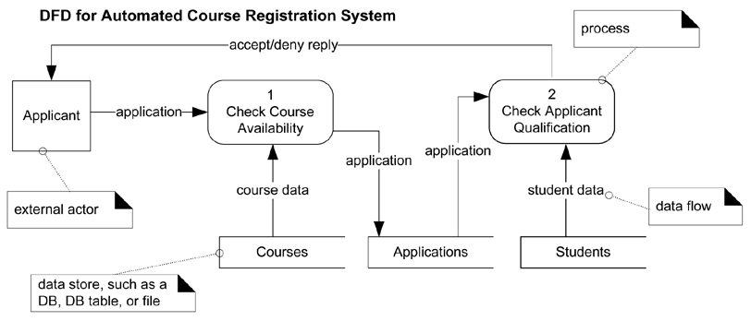
Activity diagram
Activity Diagrams v.s. Data Flow Diagams
Data Flow Diagram (DFD)

Slide 20
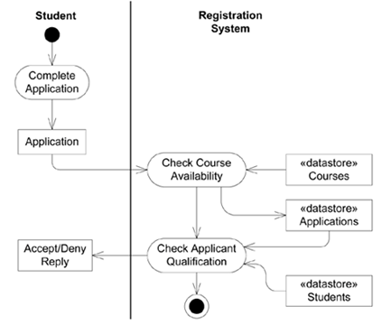
Activity diagrams
Activity Diagrams v.s. Data Flow Diagams
Activity Diagram

Slide 21
State Diagrams
State diagrams
are finite state automata
allow to model the dynamic behavior of a Communication or a class
focus on the behavior of objects, ordered by events
are especially used for modeling reactive systems

Slide 22
State diagrams
State diagrams describe the behavior of a system, part of a system or an object in the system
Each system or object has a state at a given time
In a given state, the system behaves in a specific manner to respond to the coming events
The events trigger state changes
Specifically, a state diagram models the changes of states of a system/object in response to events
A state diagram includes
State: state of a system/object at a given time
Transition: allows to switch a state to another
Event: activates the transition

Slide 23
State diagrams
State
Represents a situation of a system/object at an instance
System/object remains in a state for a while. Meanwhile, it can
perform certain activities
wait until an event occurs
Notation
Name of state
a state

Slide 24
State diagrams
Transitions
Transitions are related to actions that can be performed by the system/object associated with the diagram
Two transition types
Internal transitions to a state that react to an event without changing the current state of the system or object
The transitions between states or external transitions, which express a change in state
Example: States of an air conditioner
Cooling
decreaseTemperature
internal transition
external transition
cool
Cooling
Heating
heat

Slide 25

State diagrams
Example: Describing the states of an ATM machineSẻ
start
insert ATM card
Waiting
Serving Client
finish Transaction
event
initial state
final state

Slide 26
State diagrams
Event
Events of a transition have the following general form
Event: the event name leading to the transition
Guard: the condition must be satisfied in order to overcome the transition
Action: the operation performed when crossing the transition
Remark: some of these elements may be omitted
Event [guard] / action

Slide 27
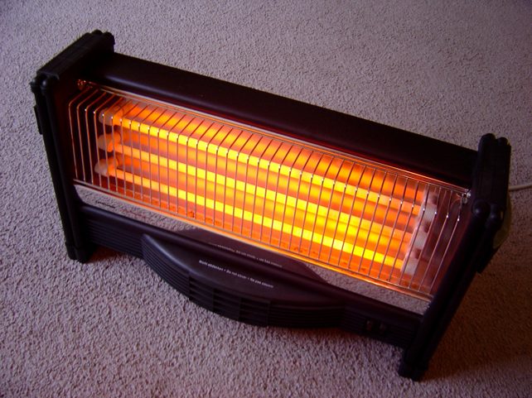
State diagrams
Event
Example: states of a heater
InActive
PressButton [The plug is connected] / heat()
Active

Slide 28


State diagrams
Example: State of a lightbulb
Off
PressOnButton [The plug is connected] / lightOn()
On

Slide 29
State diagrams
Three special events associated with state transition
entry: allows to specify an action to be performed when entering the state
exit: allows to specify an action to be performed when going out of a state
do: allows to specify an action to be performed while the system/object is in the state
Example
TypingPassword
entry / setEchoInvisible
exit / setEchoNormal
do / handleCharacter
ReceivingPhoneCall
entry / pickup
exit / disconnect

Slide 30
State diagrams
Example
Describe the behavior an “Order”
/chooseFirstProduct
[notAllControled]
/chooseNextProduct
[allControled and
allProductsAvailable]
Delivery
do / deliver()
Control
do / controlProduct()
[allControled and
allProductsNotAvailable]
livered
ReceptionProduct
[allProductsAvailable]
Waiting
Delivered
ReceptionProduct
[allProductsNotAvailable]

Slide 31
State diagrams
Composite state
Several states and the transitions between these states can be combined into a composite state
Principles
The composite state has an initial state
The transition to the composite state is immediately followed by its initial state
The transition from the composite state may be originated from any of its belonging states

Slide 32
State diagrams
Example of composite state
Active
/chooseFirstProduct
[notAllControled]
/chooseFirstProduct
[allControled and
allAvailable]
Delivery
do / deliver()
Control
do / controlProduct()
[allControled and
allProductsNotAvailable]
livered
ReceptionProduct
[allProductsNotAvailable]
ReceptionProduct
[allAvailable]
Waiting
cancel
Delivered
Cancel

Slide 33
State diagrams
Parallelism
Defining concurrent state within a composite state
Several states may exist simultaneously within a composite state
Example
Simultaneous processing of an order and its payment
Waiting
Control
Delivery
Verification
Payment

Slide 34
State diagrams
Historic state
Allowing to memorize the current state when exiting a composite state
Historic state
Active
run
H
stop
pressButton
stop
Cool
Heat
pressButton

Slide 35
State diagrams
Example
modeling an elevator’s states
ascend(f)[t>currentFloor]
ascend
[f=requestedFloor]
stop
descend(f)[f<currentFloor]
[f=requestedFloor]
descend

Slide 36

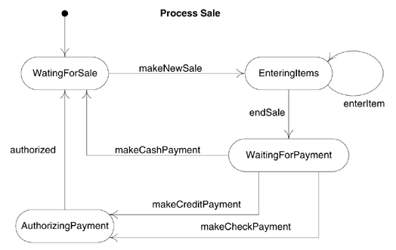
State diagram
Example
Modelling the cash register system

Slide 37
Interaction diagrams
Interaction diagrams are used to model the dynamic aspects of the system
An interaction diagram is associated with a task performed by the system or its components
Interaction diagrams are determined/built based on activity diagrams and use-case diagrams
An interaction diagram generally corresponds to a use-case or a functionality
The interaction diagram shows how objects and actors communicate together to achieve the task
Specifically, an interaction diagram allows to describe in detail the algorithms in the system
Interaction diagrams can be subsequently used in the implementation of class methods

Slide 38
Interaction diagrams
The essential elements of an interaction diagrams
Objects
Actors
Messages
Actions between objects and actors are
message sendings
object creations and destructions
Two types of interaction diagrams
Sequence diagrams
The temporal sequence of interactions
Communication diagrams
An instance of class diagram

Slide 39
Sequence diagram
A sequence diagram describes the temporal sequence of exchanges of messages between objects and the actor to perform a certain task
The actor who initiates interactions is usually found on the far left
The objects are placed horizontally on the diagram
The vertical dimension represents time
Each object or actor is associated with a life line representing the time where the object or actor is
An activation box represents the object activation period

Slide 40
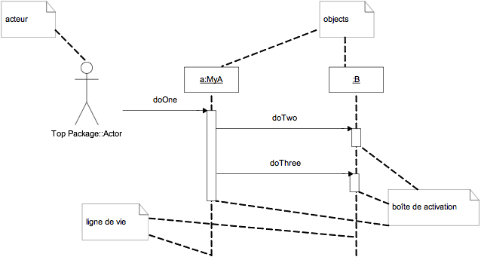
Sequence diagram
Notation
actor
activation box
life line

Slide 41
Sequence diagram
Messages
Message is the medium of communication between objects
The general form of message
guard: a condition must be satisfied in order to send the message
message: the identifier of the sent message
paramaters: a list of parameter values
Note: guard and parameters can be omitted
[guard]message(parameters)

Slide 42
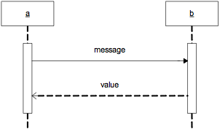
Sequence diagram
The return values
Sending a message to an object cause the execution of a method of this object
This method can optionally return a value
The return values may be omitted or be explicitly described
either as the following form
or by a return message that represents graphically
[guard]value := message(parameters)

Slide 43
Sequence diagram
Types of message
“call” message
“return” message
“send” message
“create” message
“destroy” message

Slide 44
Sequence diagram
“call” message
A “call” message invokes an operation/method of the object
A “call” message is a synchronous message: the object that sends the message must wait for the termination of the execution of the message before doing other tasks
An object can send message to itself
Notation
object A
object B
object
message()
“call” message
send message to itself

Slide 45
Sequence diagram
The “return” message returns a value for the calling object
Notation
Object A
Object B
message()
value
"return" message

Slide 46
Sequence diagram
“send” message
A “send” message sends a signal to an object
A “send” message is an asynchronous message: once the object sends the message, it expects nothing and continues to do other tasks
Notation
Asynchronous message is often used in multi-threaded environment
For example, Thread.start(), Runnable.run() in Java
object A
object B
message()
“send” message

Slide 47
Sequence diagram
“creation” message
invokes the creation method of object (constructor)
“destruction” message
invokes the destruction message of message (destructor)
Notation
“creation” message
object A
<<create>>
object B
<<destroy>>
“destruction” message

Slide 48
Sequence diagram
Example
The sequence diagram and the corresponding code
public class A
{
private B objB;
public void msg1()
{
objB = new B();
objB.msg2();
objB.msg3();
}
}
public class B
{
…
public void msg2() { … }
public void msg3() { … }
}
:A
msg1
<<create>>
:B
msg2
msg3

Slide 49
Sequence diagram
A message can be sent iteratively
Example
The message is sent 10 times
object A
object B
*[1..10]message()
for(i = 1; i<= 10; i++)
{
objectB.message()
}

Slide 50
Sequence diagram
A message can be sent iteratively based on a condition
Example
The message is sent repeatedly while
C is evaluated to true
object A
object B
*[C]message()
while(C)
{
objectB.message()
}

Slide 51
Sequence diagram
The sending of a message can depend on a decision
Example
object A
object B
object C
[C]message()
if(C)
objectB.message();
else
objectC.message();
[not C]message()

Slide 52
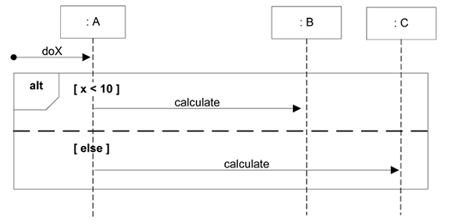
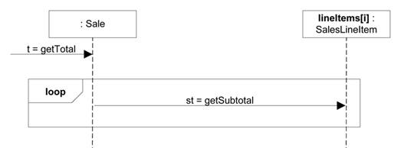
Sequence diagram
Note: UML 2.x notations allow the use of frames to represent the conditions or iterations
frames

Slide 53
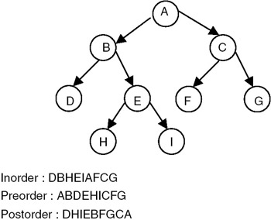
Sequence diagram
A message can be called recursively
Notation
Recursive Message
:BinaryTree
print()
print()

Slide 54
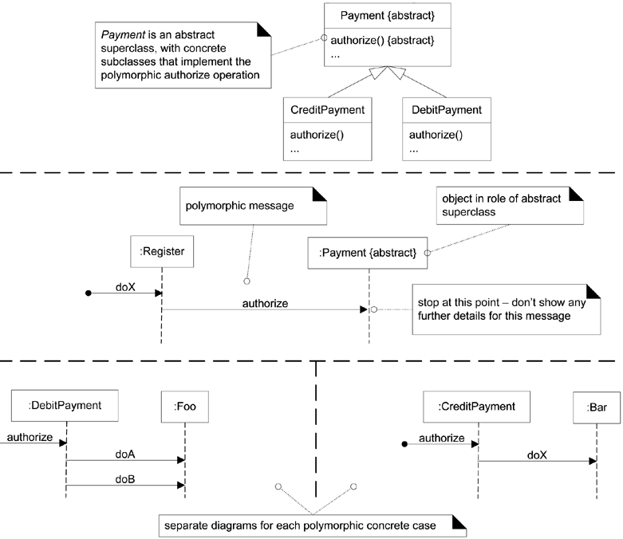
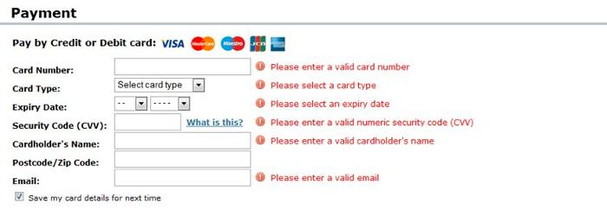
Sequence diagram
modeling a polymorphic message

Slide 55
Sequence diagram
Relationship between class diagram and sequence diagram
:Cashier
:Payment
pay(amount)
pay(amount)
Cashier
Payment
-…
-…
+pay(amount)
+…()
-currentPayment
+pay(amount)
+…()
1
1

Slide 56
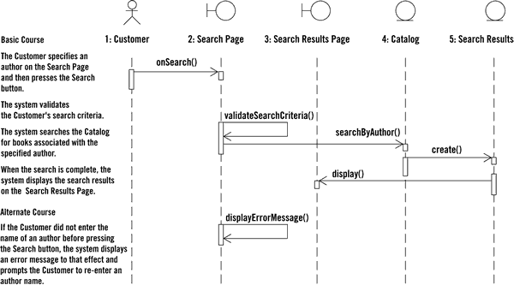
Sequence diagram from use-case

Slide 57

Sequence diagram
Example: Cash withdrawal at the bank

Slide 58
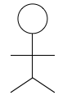
Sequence diagram
Example: Cash withdrawal at the bank
W1 : WicketSystem
C1 : CentralSystem
Teller
openSession()
enterAccount()
validateAccount()
account validated
requestOperationType()
withdrawCash(amount)
verifyAccountBalance()
balance OK
debitAccount(amount)
account debited
deliverCash()

Slide 59
Sequence diagram
Example: Use-case “cash payment”

Slide 60
Sequence diagram
Example: Use-case “cash payment”
:Cashier
:CashDesk
:Sale
pay(amount)
pay(amount)
<<create>>
:Payment
pay(amount)
returnChange
returnChange
<<destroy>>
returnChange()

Slide 61
Why not just code it?
Sequence diagrams can be somewhat close to the code level. So why not just code that algorithm rather than drawing it as a sequence diagram?
a good sequence diagram is still a bit above the level of the real code (not EVERY line of code is drawn on the diagram)
sequence diagrams are language-agnostic (can be implemented in many different languages)
non-coders can do sequence diagrams
easier to do sequence diagrams as a team
can see many objects/classes at a time on same page (visual bandwidth)

Slide 62
Communication diagram
A Communication diagram describes the interaction between objects
A Communication diagram is a graph whose
nodes represent object
edges represent the communication between objects
The temporal ordering of messages is represented by a numbering of messages
Communication diagram is an extension of class diagram

Slide 63

Communication diagram
Links
A link shows the sending of a message from an object to another object
Formally, a link is an instance of an association
Messages
Each message between objects is presented by an expression of message and an arrow showing the direction of the message
Message
A link
1: pay()
:CashDesk
:Sale

Slide 64
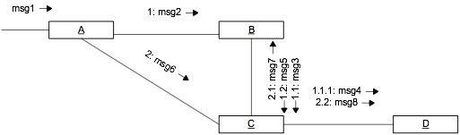
Communication diagram
“creation” message and “destruction” message
Message numbering
1: <<create>>
2: <<destroy>>
:CashDesk
:Sale

Slide 65
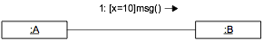
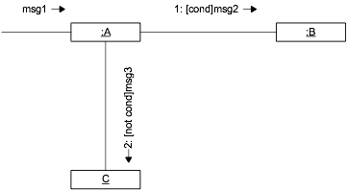
Communication diagram
Conditional message
modeling a decision

Slide 66
Communication diagram
modeling an iteration
1: *[i=1..n] res := msg
:A
:B
* indicates an iteration
1: *[cond] res := msg
:A
:B

Slide 67
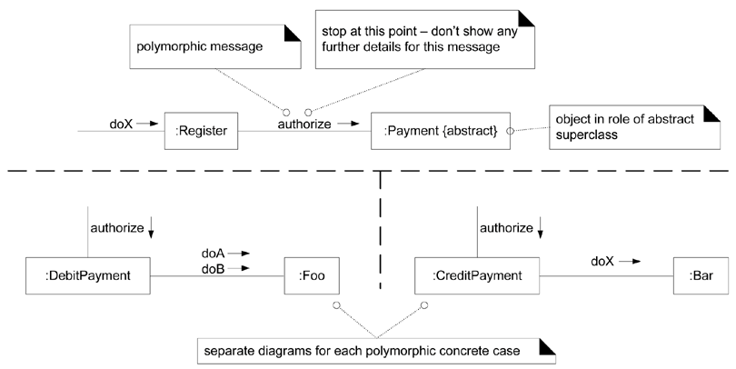
Communication diagram
modeling a polymorphic message

Slide 68
Cash withdrawal at the bank

Slide 69
Sequence diagram
Example: Cash withdrawal at the bank
W1 : WicketSystem
C1 : CentralSystem
Teller
openSession()
enterAccount()
validateAccount()
account validated
requestOperationType()
withdrawCash(amount)
verifyAccountBalance()
balance OK
debitAccount(amount)
account debited
deliverCash()

Slide 70
Communication diagram
Example: cash withdrawal in the bank
1: openSession()
2: enterAccount()
6: withdrawCash(amount)
W1 : WicketSystem
Teller
5: requestOperationType()
11: deliverCash()
4: account validated
8: balance OK
10: account debited
3: validateAccount()
7: verifyAccountBalance()
9: debitAccount(amount)
C1 : CentralSystem

Slide 71
Use-case “cash payment”

Slide 72

Sequence diagram
:Cashier
:CashDesk
:Sale
pay(amount)
pay(amount)
<<create>>
:Payment
pay(amount)
returnChange
returnChange
<<destroy>>
returnChange()

Slide 73
Communication diagram
:Cashier
:Payment
2: returnChange()
1: pay(amount)
1.1.1: <<create>>
1.1.4: <<destroy>>
1.1.2: pay(amount)
1.1.3: returnChange
1.1: pay(amount)
:CashDesk
1.2: returnChange
:Sale

Slide 74
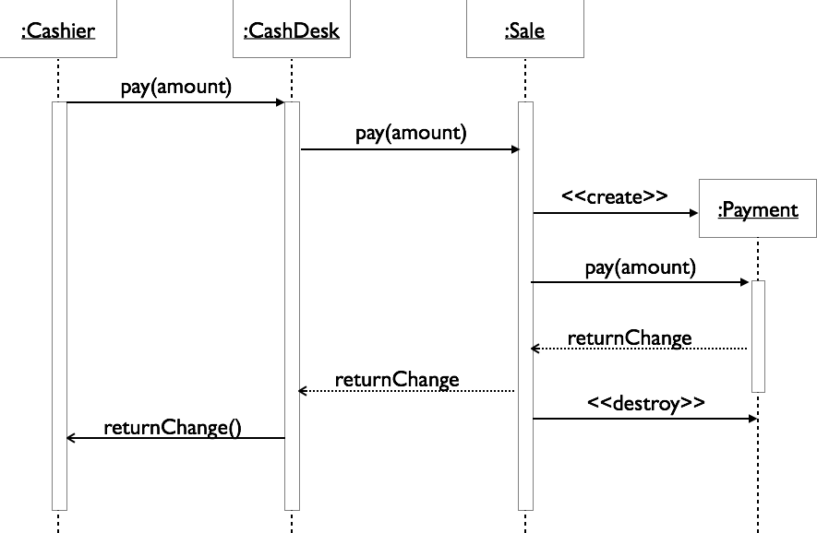
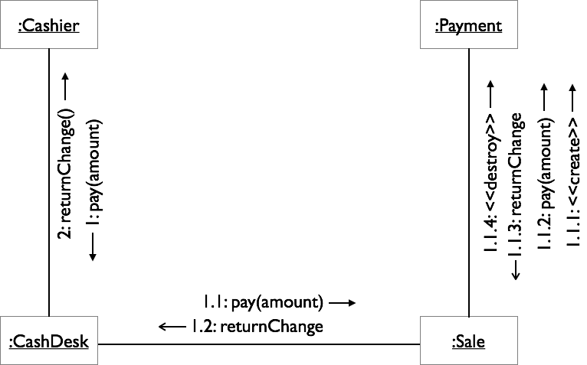
Sequence diagram v.s. Communication diagram
Sequence diagram
Clearly shows the temporal ordering of messages
Consumes space
Communication diagram
Is preferable when the interaction is deduced from the class diagram
Consumes less space
Is difficult to see the sequence of messages
v.s
Sequence diagram
Communication diagram

Slide 75
Sequence diagram v.s. Communication diagram
Both sequence diagram and Communication diagram are alternate representations of an interaction
Sequence diagram
is a graphical view of a scenario
shows object interaction in a time-based sequence of what happens first, what happens next
establishes the roles of objects and help provide essential information to determine class responsibilities and interfaces
is normally associated with a use-case
Communication diagram
shows how object associate with each other (objects, links and messages)
provides the structural relationships between objects

Slide 76
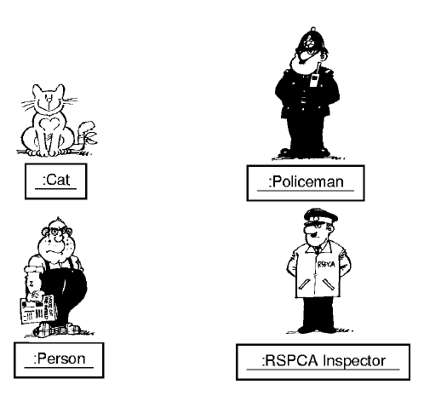
Fun example

Slide 77
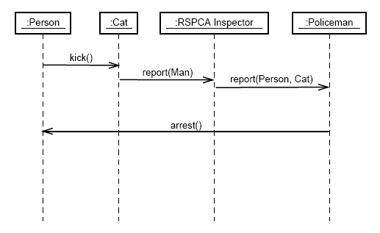
Fun example: sequence diagram

Slide 78
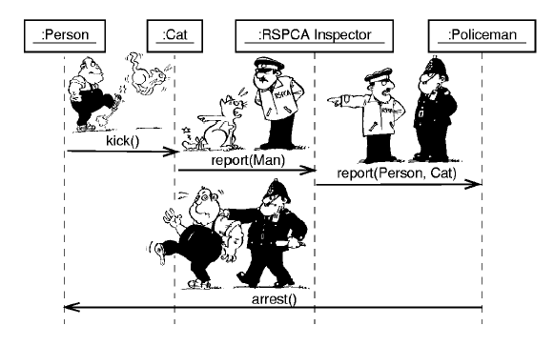
Fun example: Sequence diagram

Slide 79
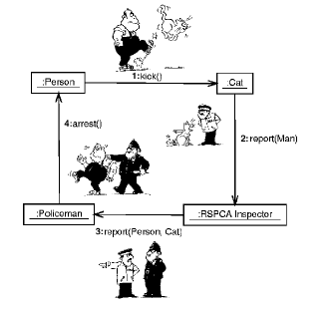
Fun example: Communication diagram

Slide 80
Project (1)
Divide groups of 4-5 students
Each group chooses a problem
Building Activity diagrams, State diagrams: Choose one of the following tools:
Microsoft Visio
StarUML: http://staruml.io/
Argo UML: https://argouml.jaleco.com/
Lucidchart: https://www.lucidchart.com/pages/examples/uml_diagram_tool

Slide 81
Project (2)
Divide groups of 4-5 students
Each group chooses a problem
Building Interaction diagrams: Choose one of the following tools:
Microsoft Visio
StarUML: http://staruml.io/
Argo UML: https://argouml.jaleco.com/
Lucidchart: https://www.lucidchart.com/pages/examples/uml_diagram_tool

